Slide 2
The Beginning: Introduction to Spatial Analysis and Data Science
Summary of GEOG0114 & Assessment
2

Slide 3
What have we covered in the last 10 weeks…
Week | Weekly Topics
1 | Spatial Analysis for Data Science
2 | Graphical Representation of Spatial Data
3 | Spatial Autocorrelation
4 | Suitability Mapping: Part I (Qualitative approach)
5 | Suitability Mapping: Part II (Quantitative approach)
Reading Week (Assessment)
6 | Geostatistics using Kriging
7 | Geodemographics
8 | Transport Network Analysis
9 | Spatial Models: Part I (Spatial Lag & Error Models)
10 | Spatial Models: Part II (Geographically Weighted Regression)
3

Slide 4
Tips/Strategy for the Assignment
4
Overarching descriptive analysis of the raster or area dataset
Basic summary measures
Spatial distribution and patterning
Description about the dataset
Areal data
Raster-based analysis
What process does the point data follow?
Moran’s I test
LISA test
Geostatistical
Point Process
To make LISA interesting – we suggest exploring multiple outcomes to examine co-occurrence of clusters
Regression-Based Models
Ordinary/Regression Kriging
Ecological Niche Model
Linear Regression Models
Standalones
Unique aggregated data for street segments?
Rasters only, and you have no
point data?
You have several independent variables at an areal level e.g., demographic, socioeconomic, and other lifestyles – you want to generate a salient category?
Spatial Lag and Error Models
Transport Network Analysis
Analytical Hierarchical Process
Geodemographic Classification
Geographically Weighted Regression
4

Slide 5
Example Data source(s)
UK Datasets
UK Census 2021: https://www.nomisweb.co.uk/sources/census_2021_bulk
UK Deprivation (2010, 2015) and 2019: https://www.gov.uk/government/statistics/english-indices-of-deprivation-2019
UK population 2010-2022 mid-year estimates: [LINK]
Police: https://data.police.uk/
CDRC: https://data.cdrc.ac.uk
London Data Store: https://data.london.gov.uk
Mosquito/species data
Global Biodiversity Information Facility: https://www.gbif.org
Global Mosquito Observatory Database (GMOD): https://experience.arcgis.com/experience/7228a5a27442468494caec2934c2b73d/page/Page/
Malaria Atlas Project: https://malariaatlas.org
Disaster-related fire datasets
Fire Information for Resource Management System: https://firms.modaps.eosdis.nasa.gov
[1] Several domestic fire outcomes (LSOA) in UK: https://assets.publishing.service.gov.uk/media/64be67369c2df000129402cf/low-level-geography-dataset-270723.ods
[2] Guidance note for [1]: https://www.gov.uk/government/statistics/fire-statistics-incident-level-datasets/low-level-geography-dataset-guidance
Disaster dataset
EM-DAT International Disaster Database: [LINK]
Humanitarian dataset
Humanitarian Data Exchange: https://data.humdata.org
Worldpop HUB: https://www.worldpop.org
Global Terrorism Database: https://www.start.umd.edu/gtd/
Armed Conflict Location and Event Data: https://acleddata.com
WHO-ESPEN Project containing tropical diseases in Sub-Saharan Africa:
https://espen.afro.who.int/ | https://espen.afro.who.int/tools-resources/cartography-database | https://espen.afro.who.int/tools-resources/download-data
Inspiration for writing methodology
Musah et al. (2020): https://doi.org/10.1016/j.apgeog.2019.102126
Todd et al. (2022): https://doi.org/10.1177/23998083211001836
Li et al. (2022): https://doi.org/10.1016/j.apgeog.2022.102718
5

Slide 6
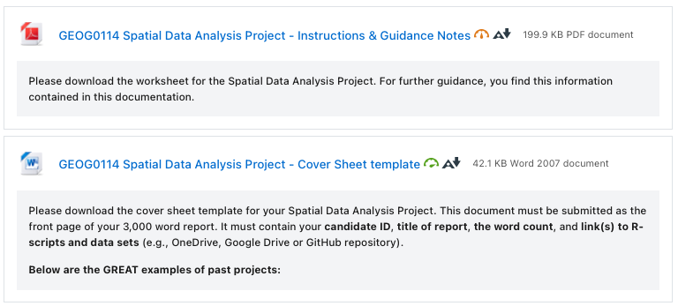
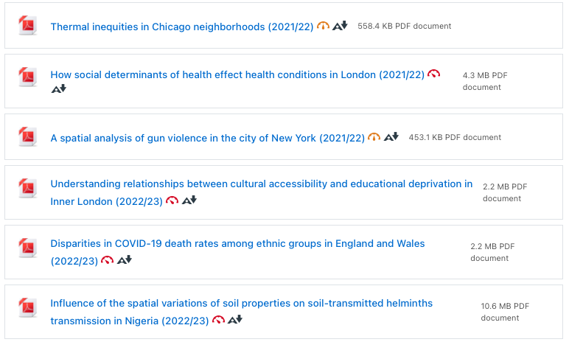
Go to Moodle’s Assessment
Assignment Documentation: Guidance notes and Cover Sheet
See Best examples of past projects from 2021/22 and 2022/23
PLEASE GO THROUGH THE DOCUMENTATION!
Spatial Data Analysis Project
Assignment’s deadline is Monday 13th January 2024 (by 12:00pm)
6

Slide 7
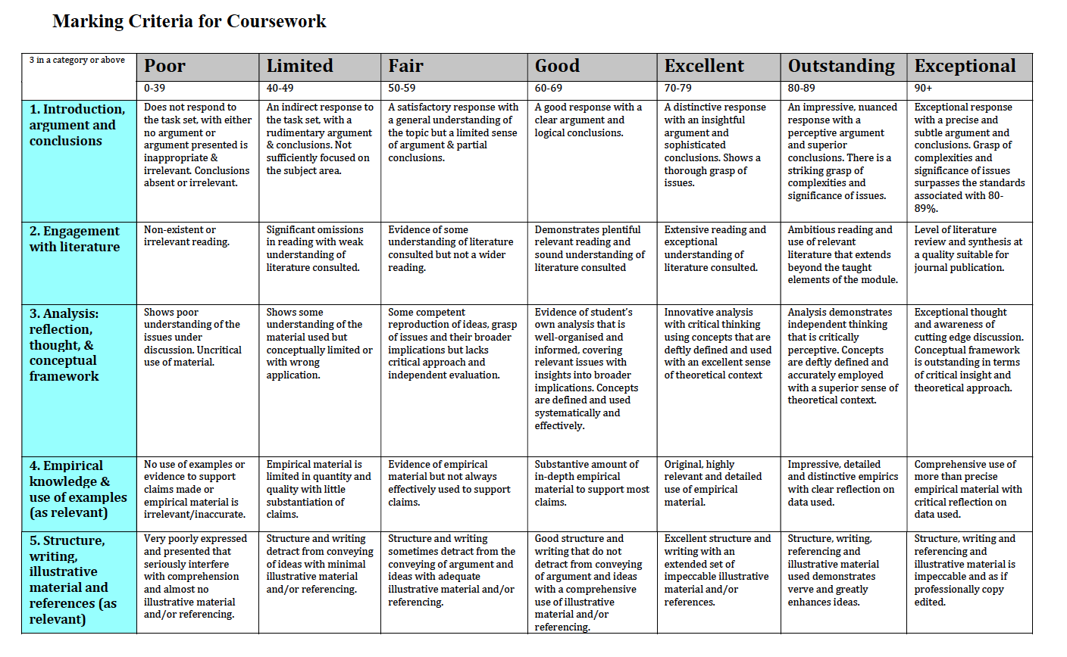
7

Slide 8
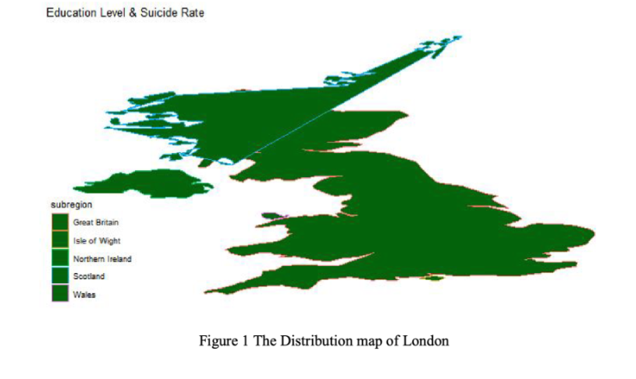
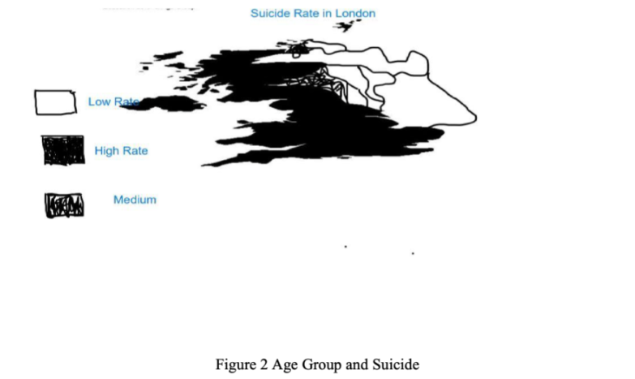
The ‘Dos’ and ‘Dont’s’
Make sure that your figures and tables are publication-worthy [1]
If you produce an image like this – it’s an automatic failure
8

Slide 9
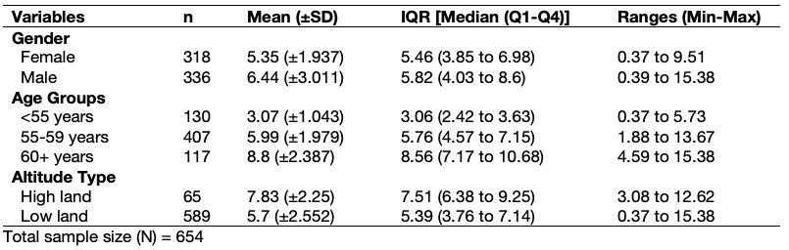
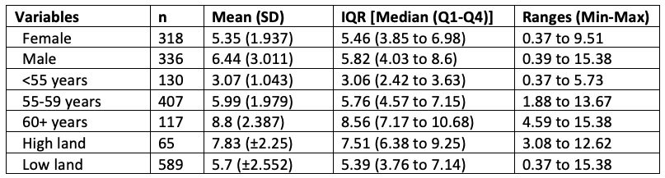
The ‘Dos’ and ‘Dont’s’
Make sure that your figures and tables are publication-worthy [2]
Best Standards:
Fully formatted table, with table legends which looks great, and it is of the standards that is considered publication-worthy. This type will yield you full marks i.e., correct results and show an eye details.
Table 2: Shows a descriptive analysis of the lung capacity function (i.e., volume) stratified by gender. Data is from among 654 respondents from the East Midlands.
Normal Standards:
Partially formatted table, with no table legends which looks rudimentary. No way near considered publication-worthy (i.e., in a report, research article, thesis etc.). The marker will be like “meh”… but if s/he (i.e., marker) is pissed-off or woke up on the wrong side of the bed, they may deduct marks.
9

Slide 10
The ‘Dos’ and ‘Dont’s’
Make sure that your figures and tables are publication-worthy [3]
# A tibble: 2 × 9
gender n mean sd median q1 q3 min max
<chr> <int> <dbl> <dbl> <dbl> <dbl> <dbl> <dbl> <dbl>
1 female 318 5.35 1.94 5.46 3.85 6.98 0.373 9.51
2 male 336 6.44 3.01 5.82 4.03 8.60 0.388 15.4
# A tibble: 3 × 9
agegroup n mean sd median q1 q3 min max
<chr> <int> <dbl> <dbl> <dbl> <dbl> <dbl> <dbl> <dbl>
1 <55 years 130 3.07 1.04 3.06 2.42 3.63 0.373 5.73
2 55-59 years 407 5.99 1.98 5.76 4.57 7.15 1.88 13.7
3 60+ years 117 8.80 2.39 8.56 7.17 10.7 4.59 15.4
# A tibble: 2 × 9
altitude n mean sd median q1 q3 min max
<chr> <int> <dbl> <dbl> <dbl> <dbl> <dbl> <dbl> <dbl>
1 high land 65 7.83 2.25 7.51 6.38 9.25 3.08 12.6
2 low land 589 5.70 2.55 5.40 3.76 7.14 0.373 15.4
Crap standards:
Not even worth the marker’s time.
If you want to alienate the markers, we dare you to submit an assignment with tables not formatted…
We double dare you to submit an output that is copied and pasted from R…
10

Slide 11
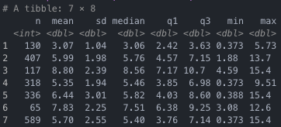
The ‘Dos’ and ‘Dont’s’
Make sure that your figures and tables are publication-worthy [4]
Really crap standards:
Even worse… we triple dare you to take a screenshot and paste it into your assignment…
11

Slide 12

“We will shut that sh*t down! No exceptions”
[Quote: Negan (The Walking Dead, Season 6, Episode 16 [Last Day on Earth])
12

Slide 13
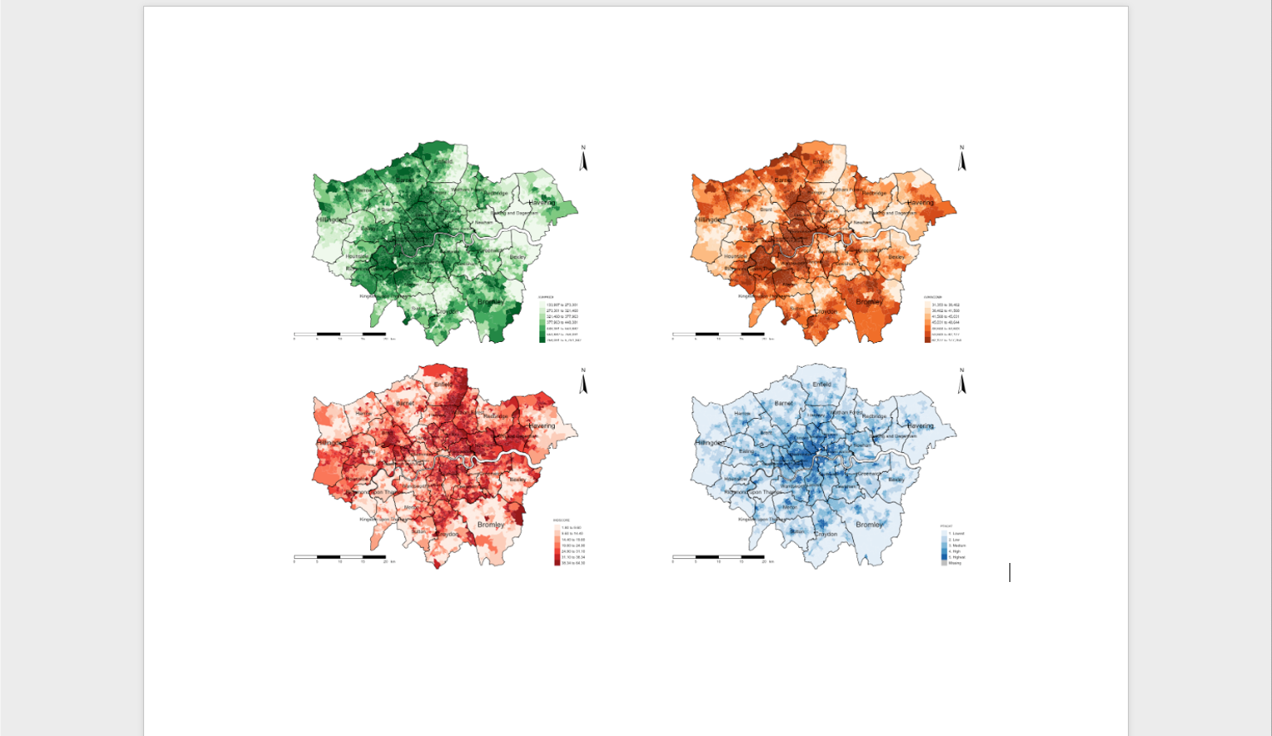
The ‘Dos’ and ‘Dont’s’
Readability of outputs and formatting of pages [1]
If you have multiple figure outputs, you are welcome to generate a panelled figure that is annotated alphabetically.
The issue is that squeezing a panelled figure on portrait document reduces it readability severely.
You should pay close attention to even these little things to avoid alienating your marker.
A
B
C
D
For the marker to make sense of this image, s/he
will be forced to zoom in the +400% any to still see
blurry figure…
13

Slide 14
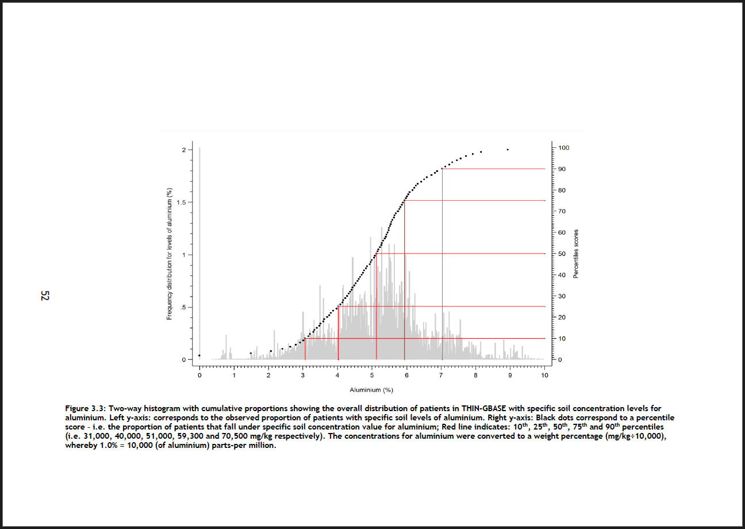
The ‘Dos’ and ‘Dont’s’
Show the image in its glory to the fullest by taking advantage of the landscape settings
Readability of outputs and formatting of pages [2]
This is a crude example to illustrate what I mean about showing your results nicely to its fullest glory.
Notice the page number has been formatted accordingly to the width of the page, instead of it being on the length to ensure consistency in the page number position if the document was printed.
Markers appreciate this level of detail and are not above being sympathetic in awarding extra marks for quality in presentation.
14
Notes:
Flexibility with page numbers

Slide 15
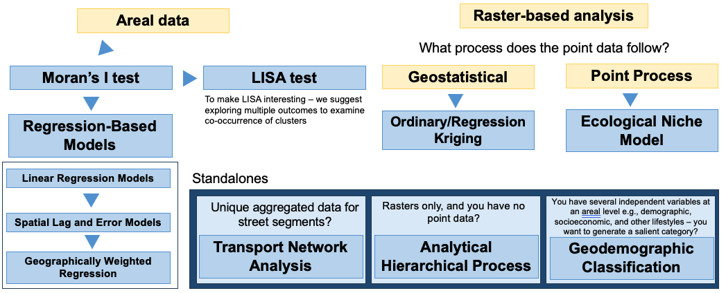
The ‘Dos’ and ‘Dont’s’
Avoid violating the core assumptions behind these analytical techniques
Any violation of the core assumptions – whether it be data-related, or distributional will be considered as a critical error.
Marks will be deducted accordingly. It should be noted that your marks are capped at 68/69.
If it’s horrible violation, to such extent its irredeemable, then in such scenario can potentially lead to a failing grade.
15

Slide 16
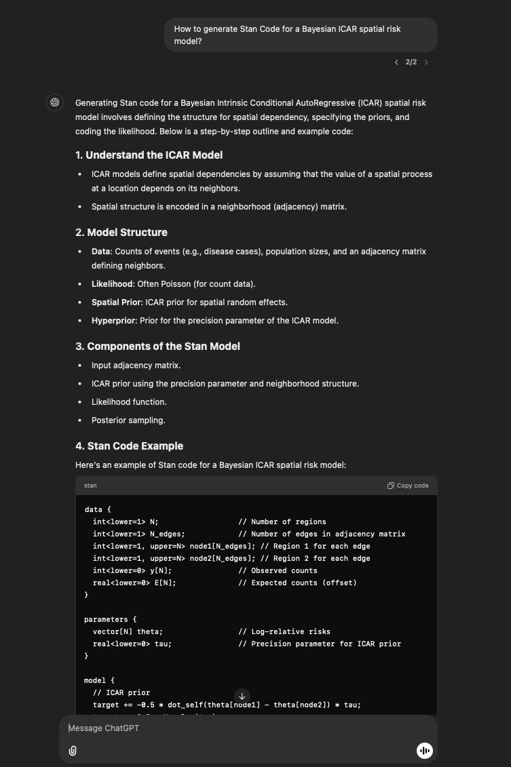
The ‘Dos’ and ‘Dont’s’
Use of Generative AI (e.g., ChatGPT) and References
If you're using GenAI to assist or troubleshoot with the R coding part of the assessment, that's perfectly fine. You just need to acknowledge the use of GenAI in your methodology section, especially if it was used for straightforward tasks like data cleaning or manipulation.
“I acknowledge the use of ChatGPT (https://chatgpt.com/) to improve my writing, and assistance with R coding”
However, if GenAI was used for more significant contributions, such as getting information to describe the statistical methodology or modelling approach, you must provide a proper citation. UCL offers guidelines on how to cite GenAI in such cases. For example, if I asked ChatGPT the following:
“How to generate Stan Code for a Bayesian ICAR spatial risk model?”
How to generate Stan Code for a Bayesian ICAR spatial risk model? (2024). ChatGPT (GPT-4o). Wednesday, 27 November. Available at: https://chatgpt.com/c/67471449-f31c-800c-a6e9-f22b554f7841
UCL Policy on referencing GenAI [LINK]
UCL Geography’s Policy on using GenAI in MSc assessments/Dissertations [LINK]
16

Slide 17
GEOG0114: Course Evaluation & Student Feedback (Week 7-10)
https://forms.gle/2bgUnHgY14vYzDsS9
Dear Students,
As part of the Continuous Module Dialogue, we are conducting this survey to gauge the levels of student satisfaction with the learning experience in module GEOG0114: Principles of Spatial Analysis. We would like to receive your feedback, which would be greatly appreciated. This will help us make improvements to the course. The survey should only take up to 5 or 10 minutes, and your responses are completely anonymous.
Thank you,
Anwar and Justin.
17

Slide 18

See you in term 2
18

